Slide 1
Cognitive correlates of First-Person Shooter gaming: A cross-sectional study of Counter-Strike players
Eleanor R. A. Hyde, Robert Schmidt, Daniel J. Carroll and Claudia C. von Bastian
31/10/2024
ERNC 2024

Slide 2






Cognition: Mental Processes
Cognitive Correlates
Cognitive Plasticity

Slide 3

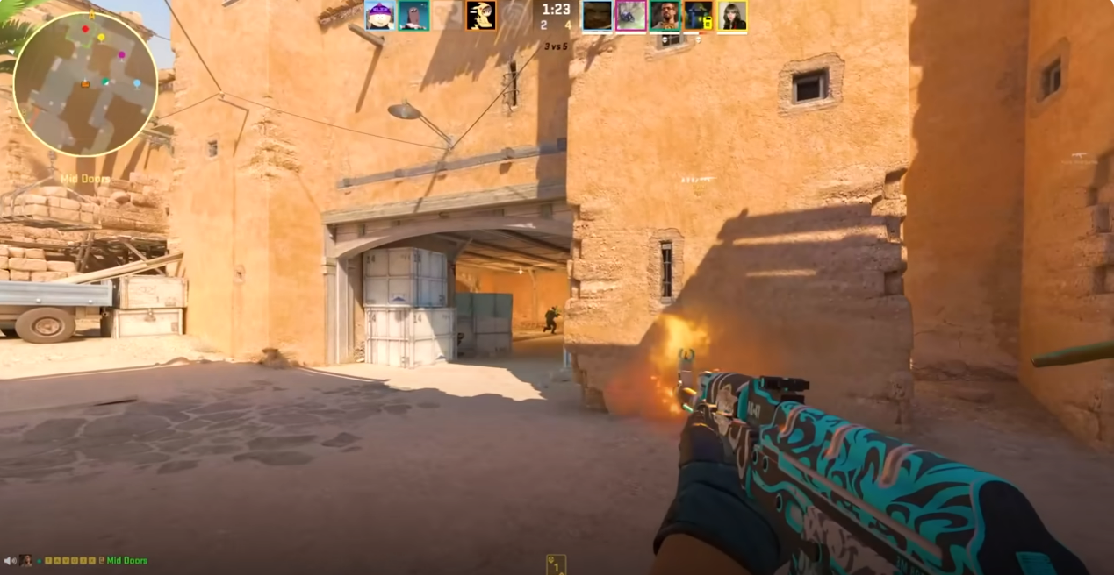


Leisure Activities
Cognitive plasticity can be enhanced through engagement in cognitively challenging leisure activities (von Bastian, Hyde & Jiang, 2023)

Slide 4



Previous Methodological Limitations
Research shows mixed findings for the cognitive correlates of FPS gameplay:
Broad definitions of video games
Small samples of novice players
Limited assessment of video game skill

Slide 5


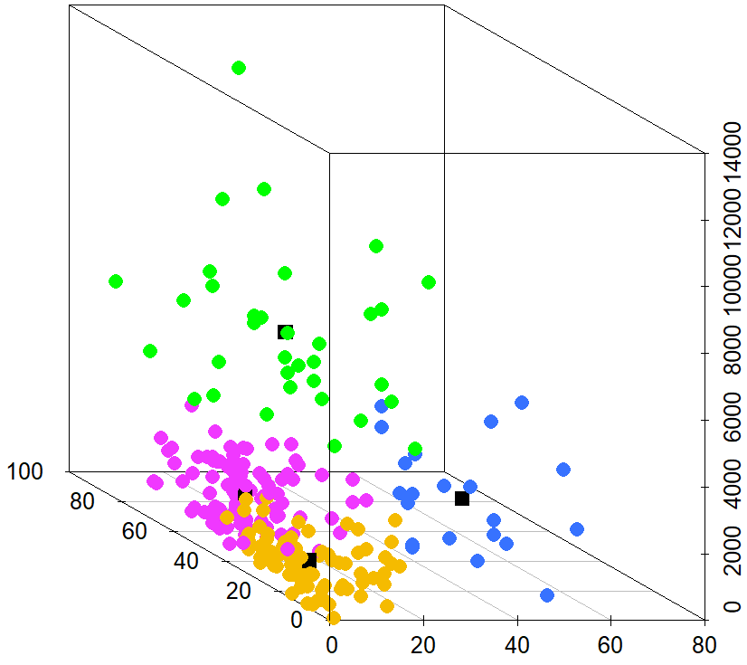
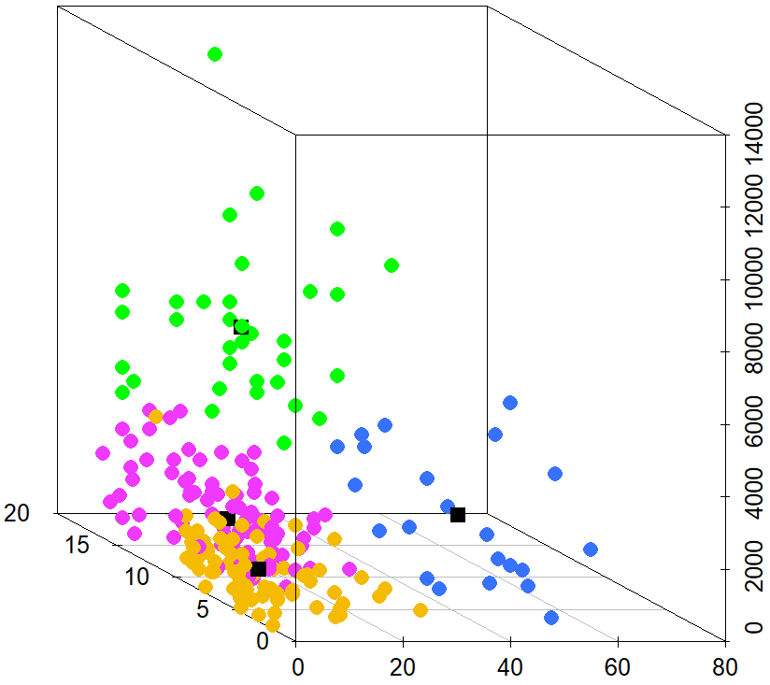
Method: Counter-Strike Skill
Semi/Professional (n = 34) | Experienced (n = 101)
Aspiring (n = 22) | Novice (n = 78)
K-means cluster analysis
Total Hours
Total Hours
Self-Rated Skill
Current Ranking
Weekly Hours
Weekly Hours

Slide 6



Method: Cognitive Task
Choice Reaction Time Task
Blue or Green
Curvy or Spiky

Slide 7
Measures: Reaction Times (RTs)
Single Trail RTs: general processing speed ability
Mixing Trail RTs: ability to conduct two or more tasks in close succession
Switching Trial RTs: ability to switch from one task to another

Slide 8
Processing Speed
Evidence of an effect of skill group on single and switching processing speed
M = 591, SD = 112

Slide 9
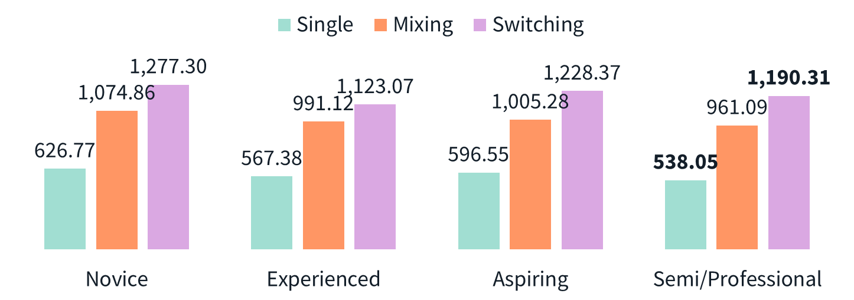
The Drift-Diffusion Model
1. Drift Rate (v) information accumulation
2. Boundary Separation (a) response caution
3. Non-decision time (t0) other non-decisional processes
Drift Rate (v)
Boundary Separation (a)
Green
Blue
Encoding
Decision Time
Response Execution
Non-decision time (t0)

Slide 10

The Drift-Diffusion Model
Evidence of an effect of skill group on switching drift rate, single boundary separation and single non-decision time
M = 591, SD = 112

Slide 11
Summary
RTs: Semi/Professional players demonstrated faster processing speed on single trials
But Experienced players were faster on switch trials
DDM: Semi/Professional players showed faster non-decision times, but greater boundary separations in single trials. But higher drift rates in switch trials.

Slide 12
Take-home message
Cognitive Correlates
Greater FPS skill associated with faster processing speed, but performance advantages go beyond simple RT benefits – utilisation of decisional strategies
Cognitive Plasticity
Greater FPS skill associated with greater efficiency in fast decision-making (von Bastian et al., 2022)

Slide 13





Thank you! ww.eleanorhyde.com erahyde1@sheffield.ac.uk
Supervisory Team
Claudia
von Bastian
Dan Carroll
Robert Schmidt

